Slide 1
Hawaii’s Administrative Rules Improvement Initiative
National Association of Secretaries of State
Administrative Codes and Registers Section
Summer Conference 2017
Indianapolis, IN

Slide 2
The Aloha State: Fast Facts
Geography
Most isolated populated archipelago
8 inhabited islands
25% of US’ endangered species are only in Hawaii
Demographics
1.3 million resident and 8 million visitors
Minority-majority state since always
Highest per capita Spam consumption
Longest life span in US
Unless you are Native Hawaiian

Slide 3
State Government
Statehood in 1959
Territory from 1898
Kingdom from 1795
Organized populations from 1200
Legislature
25 Senators
51 Representatives
Supermajority in both chambers
Executive
18 Cabinet agencies, plus Board of Education (Libraries) and University of Hawaii
Department of Health: public health, mental health, and environmental management
No Secretary of State
Lieutenant Governor is a limited analog

Slide 4
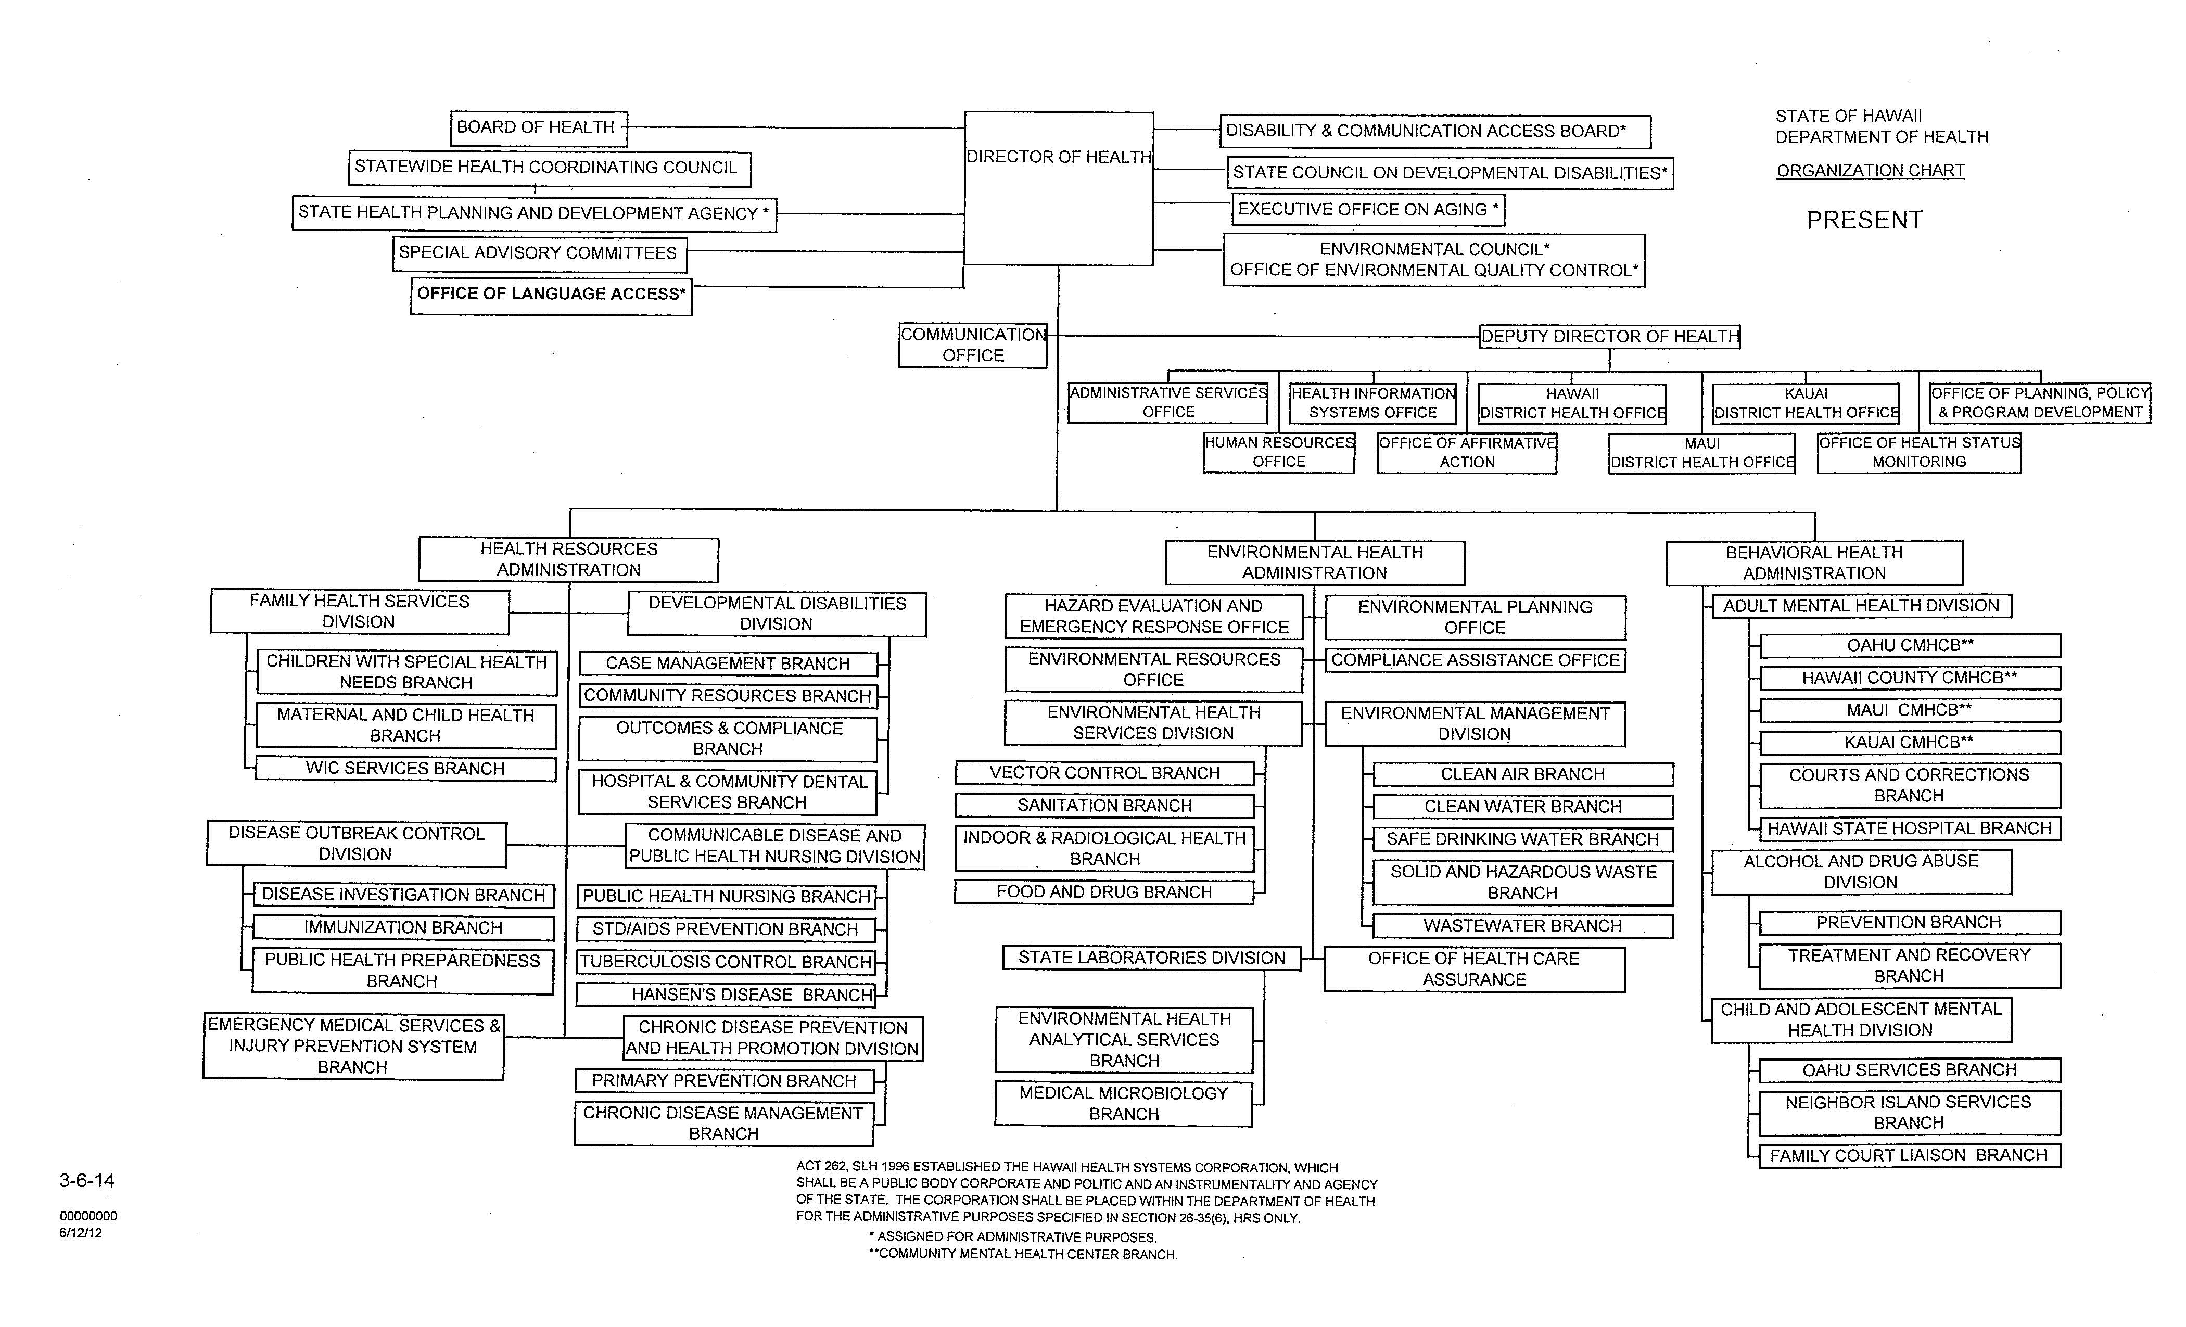

Slide 5
Administrative Rules Policy Framework
Chapter 91 HRS
30 days notice of public hearing though comments are non-binding
Small Business Regulatory Review Board
Approval by the Governor
Section 201M-2 HRS
Small business impact determination and report by agency
Section 321-9 HRS
The department of health may adopt a seal and may adopt such rules and regulations as it may consider expedient for the conduct of its business. The department may amend or revise such rules and regulations from time to time.
Administrative Directive 09-01

Slide 6
Artifacts of Administrative Rule Making
http://health.hawaii.gov/opppd/department-of-health-administrative-rules-title-11/

Slide 8
Question | Summary of comments | Analysis
Do you anticipate new rule writing or rule amendment/updating? 28 responded, 1 skipped | 24 yes = 85.71% 4 no = 14.29% 1 no response | 85.71% responding have rules to promulgate.
What type of staff works on rules? 29 responded | 14 specialist = 63.64% 11 Scientific = 50% 5 Clerical = 22.73% | Rules are written by professional staff with clerical support.
What are the major barriers or constraints to keeping rules up-to-date/promulgating new rules? 26 Answered, 3 skipped | Training: Updated guide & documents esp. SBRRB process, want orientation, training, workshops. 4 respondents Staffing issues: no time, volunteer board w/no staff or budget, lack of experience, setting up technical committee, need good writer. 10 respondents Process is long: Long approval process, lengthy process, coordination of hearings process on the neighbor islands or sites using VCC, ads in paper takes time, complex process. 8 respondents Deputy Attorney General: takes time going to AG, limited support from AG. 2 respondents Formatting document: Ramseyer, rules format. 2 respondents | Staffing issues are the major concern from programs in promulgating rules. Also, to be considered is that the process needs to be clear and useful tools would be welcomed.

Slide 9
How much staff time is spent working on rules per month/year? 27 responded, 2 skipped. | 0-10 hours per month depending on where rule is in process. 25-30 hrs. 40-80 hrs. <500 hours per year Non-routine task 1-3 days per month 20% of time over 3 year period. | The time programs spend on rules varies per program, experience, and need.
What suggestions do you have to improve the rules experience? 26 responded, 3 skipped. | Training session, orientation and help along the way, flow chart of process and training, Workshop and formatting. Support from rule making specialists, centralized office is good with experts. Clearer examples on formatting. Set benchmarks. Electronic system for routing. Clerical support and staffing needed. Program needs resources to write rules. AG delays are long. | Respondents commented that a clear process would help along with good training or an orientation on rule promulgation.
What tools/templates/resources do you find useful in your program to develop rules? 26 responded, 3 skipped. | Hawaii Administrative Rules Manual. – 7 respondents Other staff who have gone through process or historical documents. – 5 respondents OPPPD. – 3 respondents Updated flow chart/Manual on the process. – 2 respondents Format help like Adobe, other states and regulations. – 9 respondents | Respondents felt that the Hawaii Administrative Rules Manual was the most helpful. Additionally, respondents would specifically appreciate help with the use templates to assist in formatting and figuring out what to do based on examples.

Slide 10
OMG HELP
What is the optimal organizational structure?
What skills are the most and least transferrable?
What training is necessary?
How do you measure skill and effectiveness?
What is the value-add to:
Centralization of drafting?
Distributed or federated drafting?
What are common tools of the trade?

Slide 11
Mahalo.
Lorrin Kim
Chief, Office of Planning, Policy, and Program Development
Hawaii Department of Health
lorrin.kim@doh.hawaii.gov

